Slide 1
ECLI-codes and Network Analysis
Gijs van Dijck
Professor of Private Law

Slide 2

Old School Legal Research

Slide 3
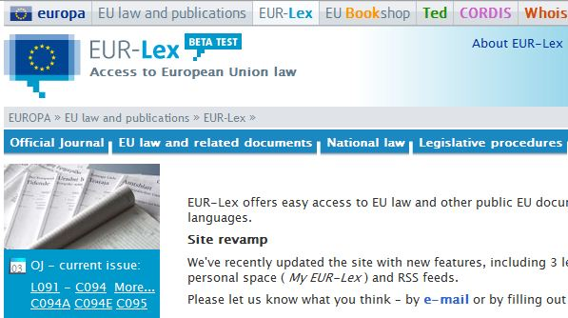
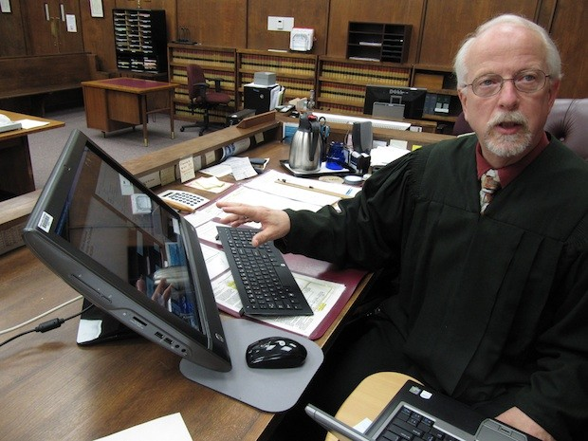
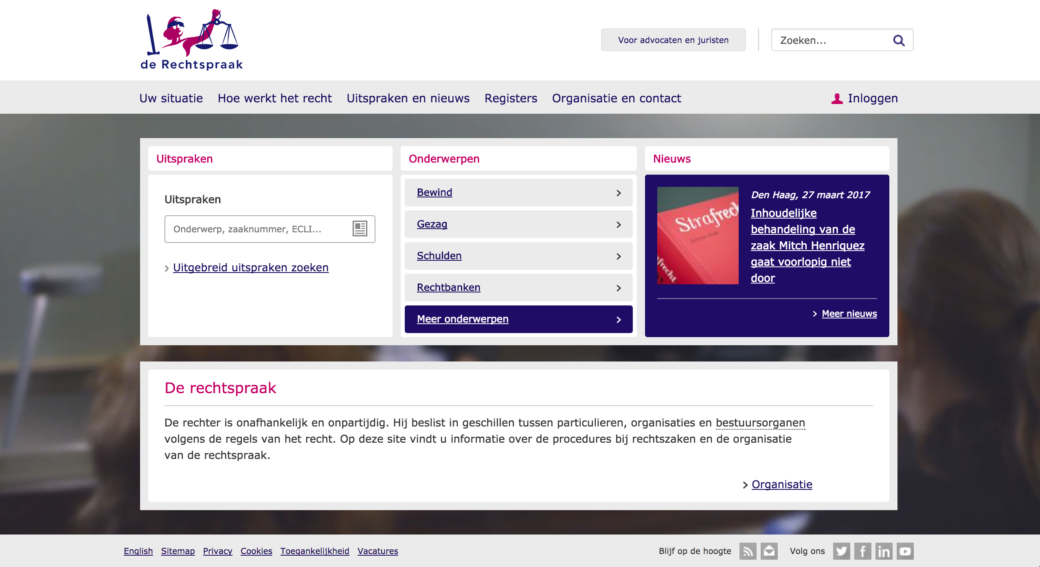
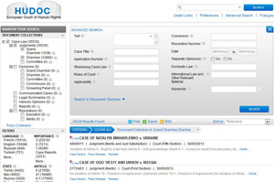
The Digital Revolution

Slide 4
Search Process versus Analysis
Finding relevant precedents
  Practice of using a rule set in a prior legal case to decide subsequent cases
Case Synthesis
  Compare outcomes with facts

Slide 5
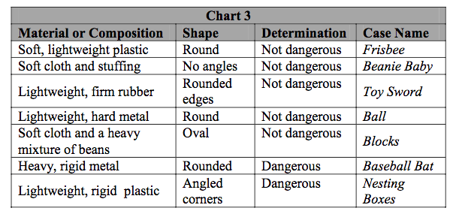
Case Synthesis (example)
Hypotheses: Material, Composition and/or Shape Explain Case Determination
Source: Gionfriddo 2007

Slide 6
Search Process versus Analysis (2)
Finding relevant precedents
  Practice of using a rule set in a prior legal case to decide subsequent cases
Case Synthesis
  Compare outcomes with facts
Citations
  Assumption: references to other decisions are meaningful (not random)
→ Network Analysis

Slide 7
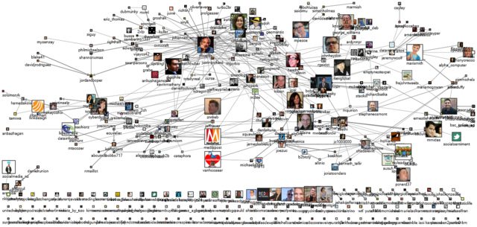
Network Analysis (Twitter social network)
Source: https://c1.staticflickr.com/5/4001/4618279087_fb950e357d_z.jpg

Slide 8
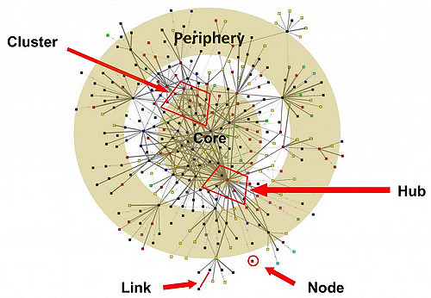
Network Analysis

Slide 9
Network Analysis
In-degree
Precedent

Slide 10
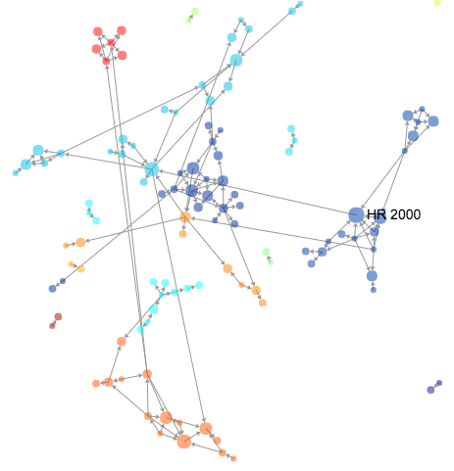
Example: Employer Liability

Slide 11
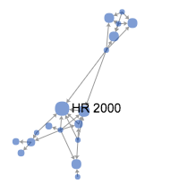
Example: Employer Liability (cont’d)

Slide 12
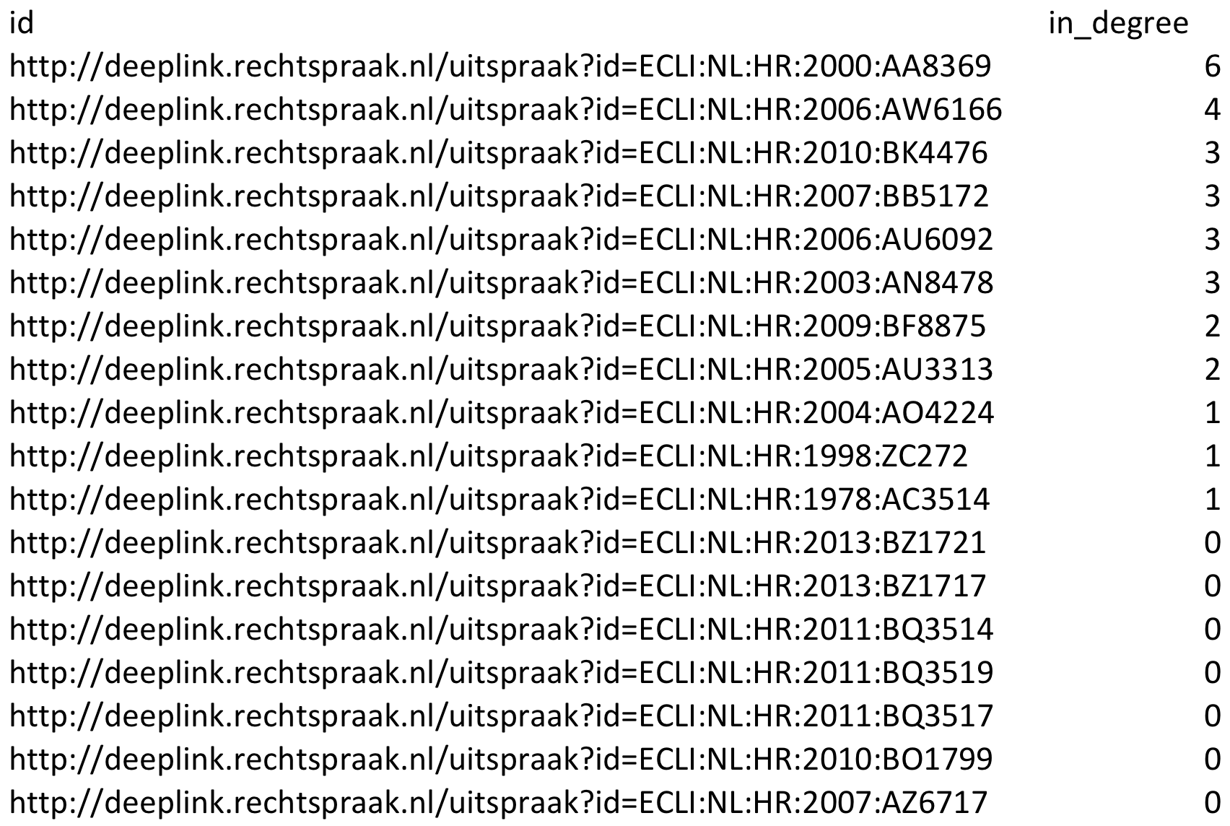
Example: Employer Liability (cont’d)

Slide 13
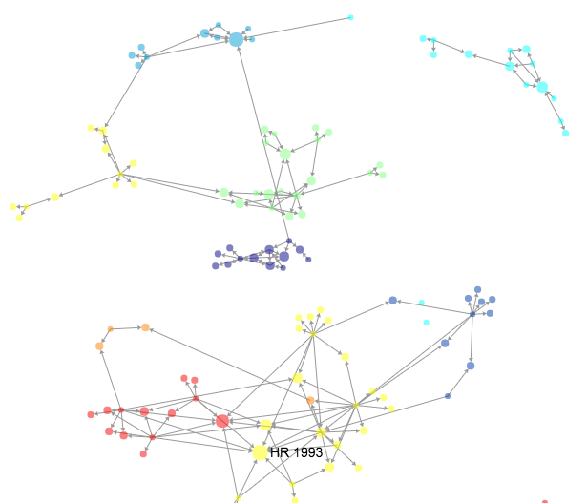
Other Examples (standard terms)

Slide 14
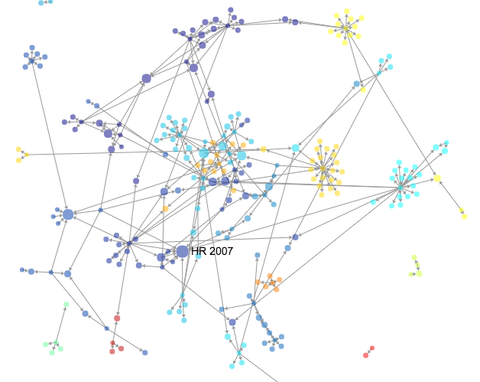
Other Examples (non-conformity)

Slide 15
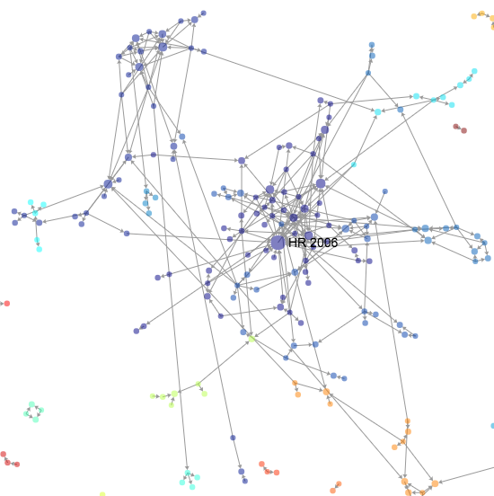
Other Examples (director liability)

Slide 16
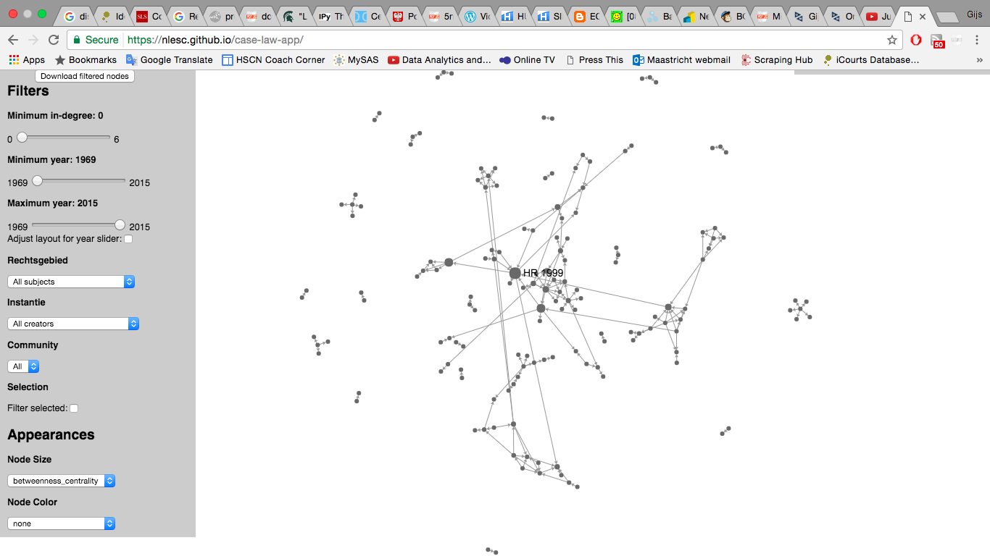
Glue of the Network

Slide 17
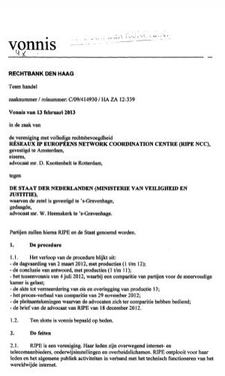

ECLI and Network Analysis

Slide 18
Challenges
ECLI Identifier
  Domestic Law
  EU Law
  Combine Jurisdictions (eg impact)
Cluster Detection
Development of Case Law
Text Mining
  Expanding Search Functions
App(lication)

Slide 19
Acknowledgments
Visualization Tool
  eScience Center (Dafne van Kuppevelt)
  (https://www.esciencecenter.nl/)
Examples
  Blazej Fiks
  Myron Matthews
  Dennis Meens
  Caspar Otten
  Joey van de Pasch

